Slide 1
Data Structures Workshop
Day 21

Slide 2
Workshop Outline
Post Exam 2 Depression
Trees Overview
Binary Search Trees (BST’s)

Slide 3
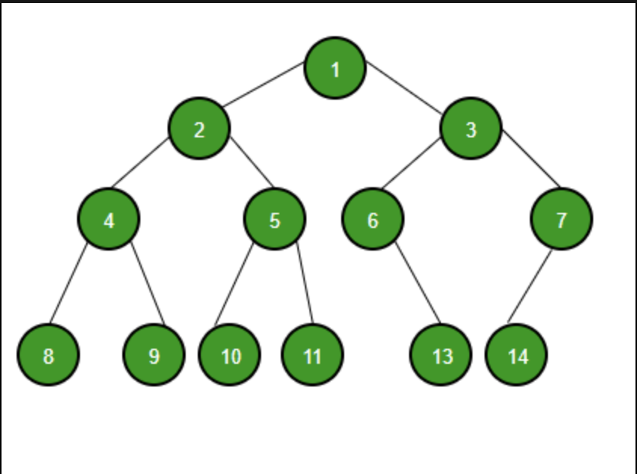
Binary Trees
A binary tree is a tree data structure in which each node can have at most two children, which are referred to as the left child and the right child.
Each node contains the following:
Data Item
Pointer to Left Child
Pointer to Right Child

Slide 4
Tree Terminology
Node - entity that contains a value and pointers to its child nodes
Root - topmost node of tree
Leaf - node in tree that does not have pointers to child nodes
Edge - link between any two nodes
Node Height - number of edges from node to the deepest leaf
Node Depth - number of edges from the root to the node

Slide 5
Types of Binary Trees
Full Tree - every node contains either 0 or 2 children
Complete Tree - all levels contains all possible nodes
Perfect Tree - all internal nodes have 2 children and all leaf nodes are at the same level

Slide 6
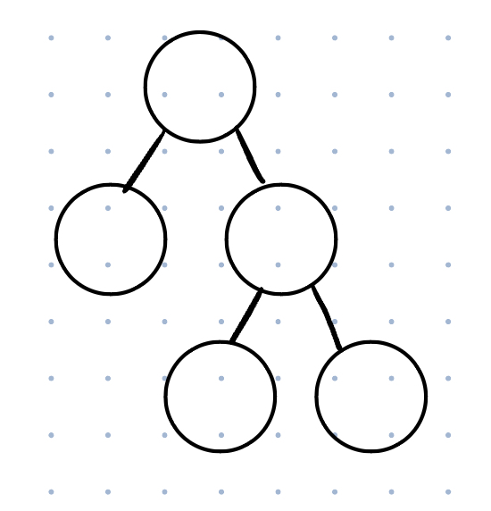
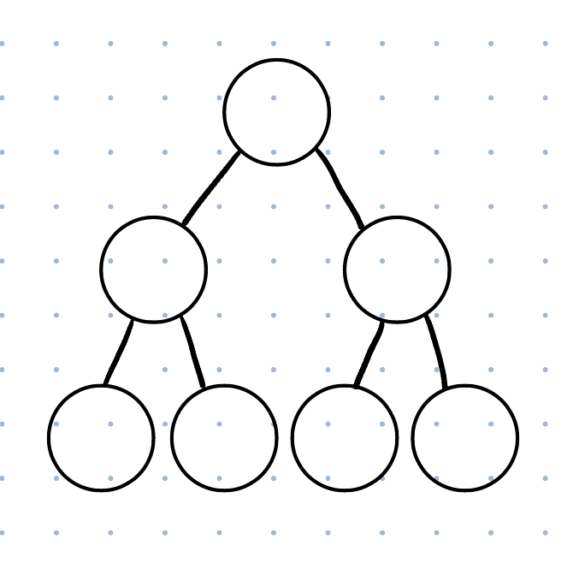
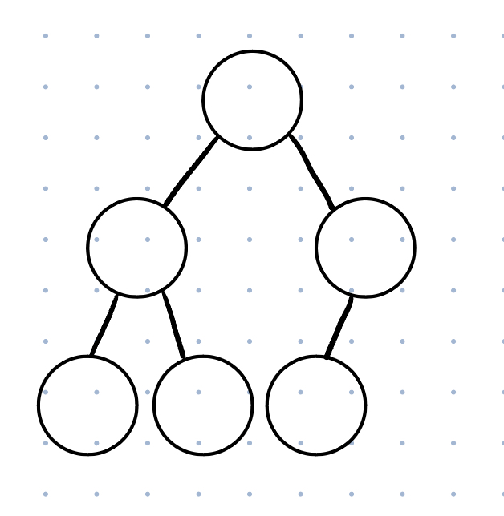
Identify The Following

Slide 7
Binary Search Trees

Slide 8
What is a Binary Search Tree?
Variation of a Binary Tree
BST’s have the following properties:
All nodes in the left subtree of root node are less than the root node
All nodes in the right subtree of root node are greater than the root node
Both subtrees of each node are also BST’s
(Also assume all values in a BST are unique)
These allow us to search for a value in O(log(n)) time (best case), which makes it efficient!
Worst Case for Search is O(n)... why?

Slide 9
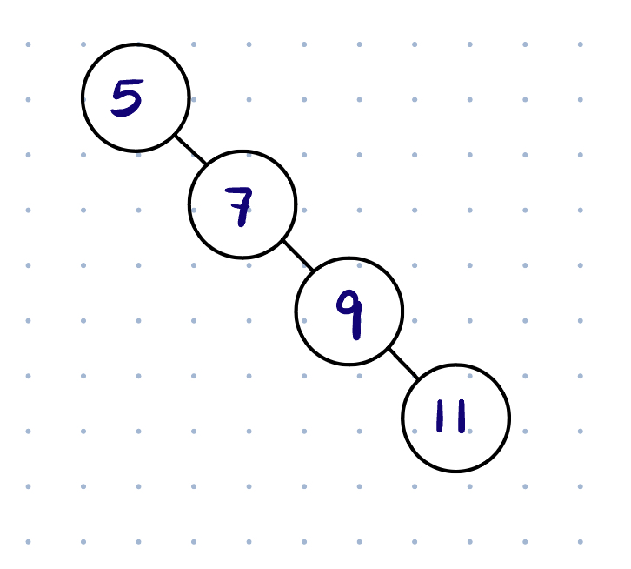
BST Worst Case Search
Search for “11”
By nature of the BST, in some cases, insertion into the BST is not balanced
Here, we see the search of the value “11” will run along the height of our tree, which is “n” nodes → O(n)

Slide 10
BST Implementation

Slide 11
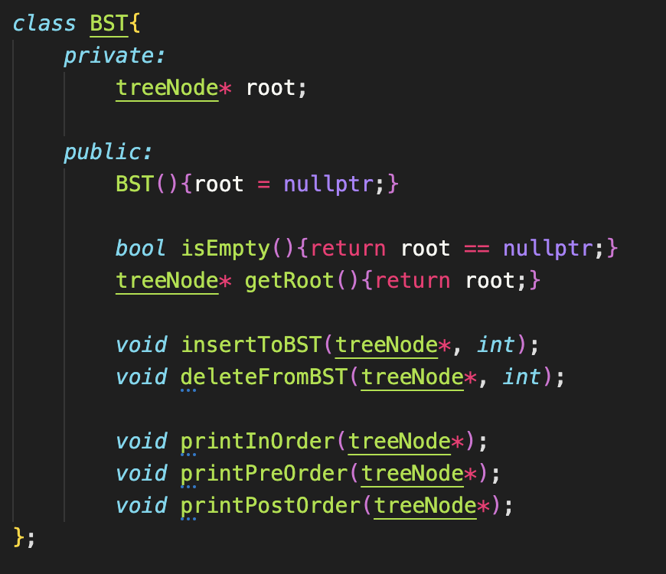
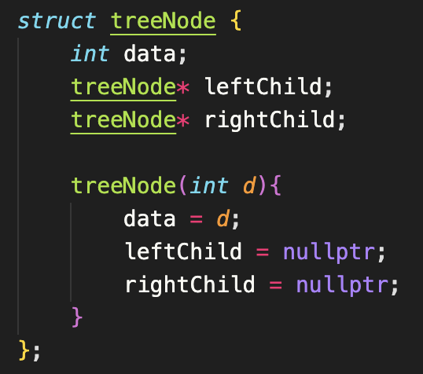
Implementation (Class & ADT)

Slide 12
BST Insertion

Slide 13
BST Insertion
When inserting in our BST, we first need to find the indicated place to insert our value to. Here’s the idea:
First, we start on the root of the tree and identify if our value is less than or greater than the node we’re on
If it’s less, we recursively call left subtree
If it’s greater, we recursively call right subtree
Traverse until you’ve reached the end of the tree
Insert value

Slide 14
Insertion Tracing
Insert the following values into a BST:
[10, 5, 25, 15]

Slide 15


Slide 16
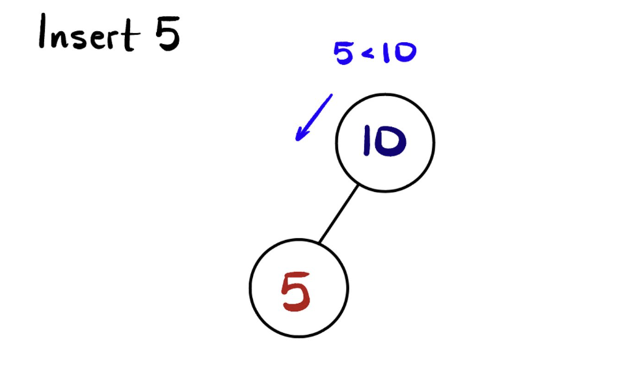

Slide 17
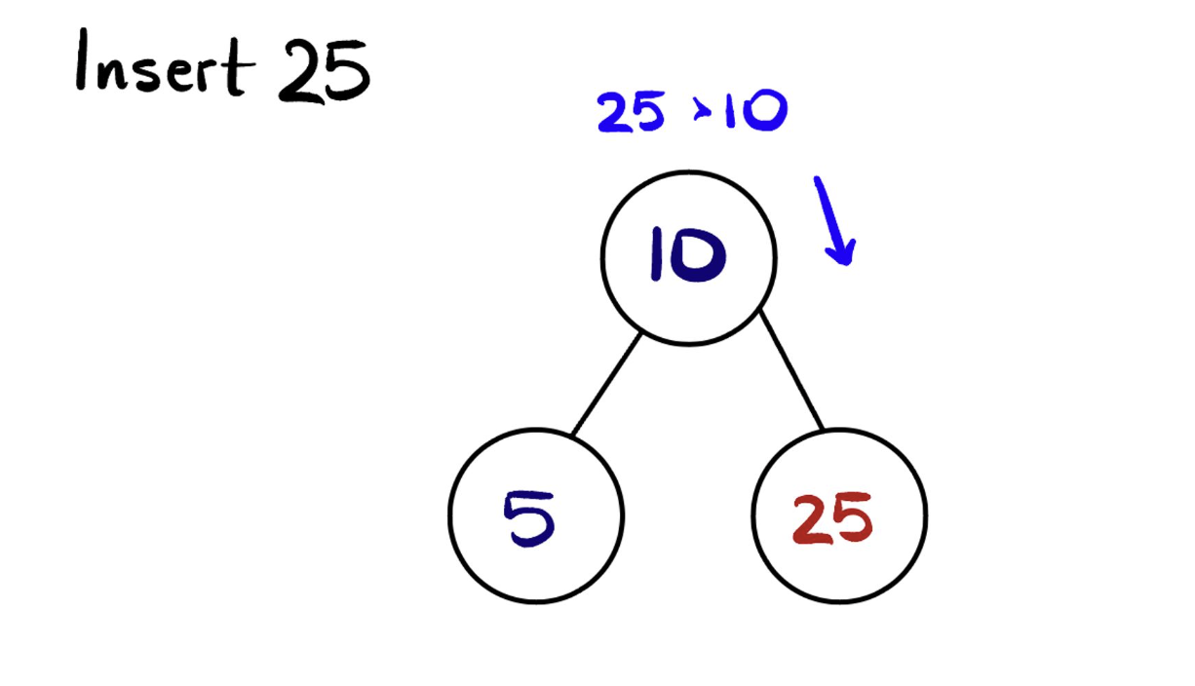

Slide 18
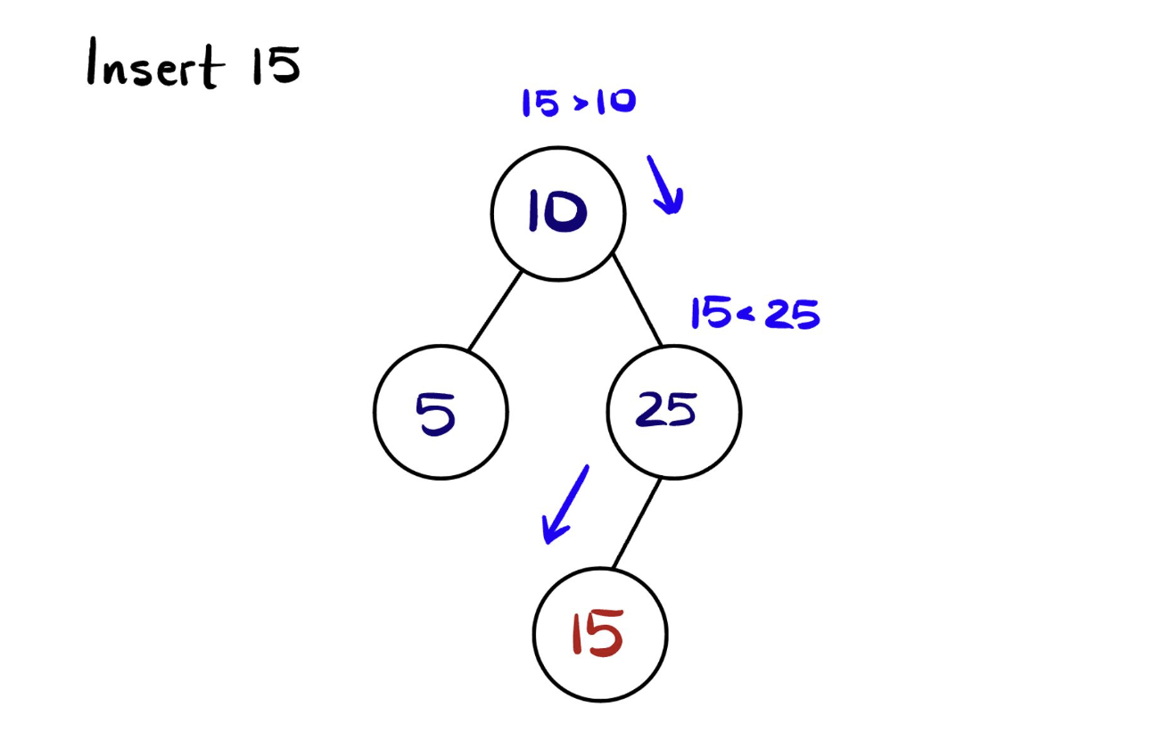

Slide 19
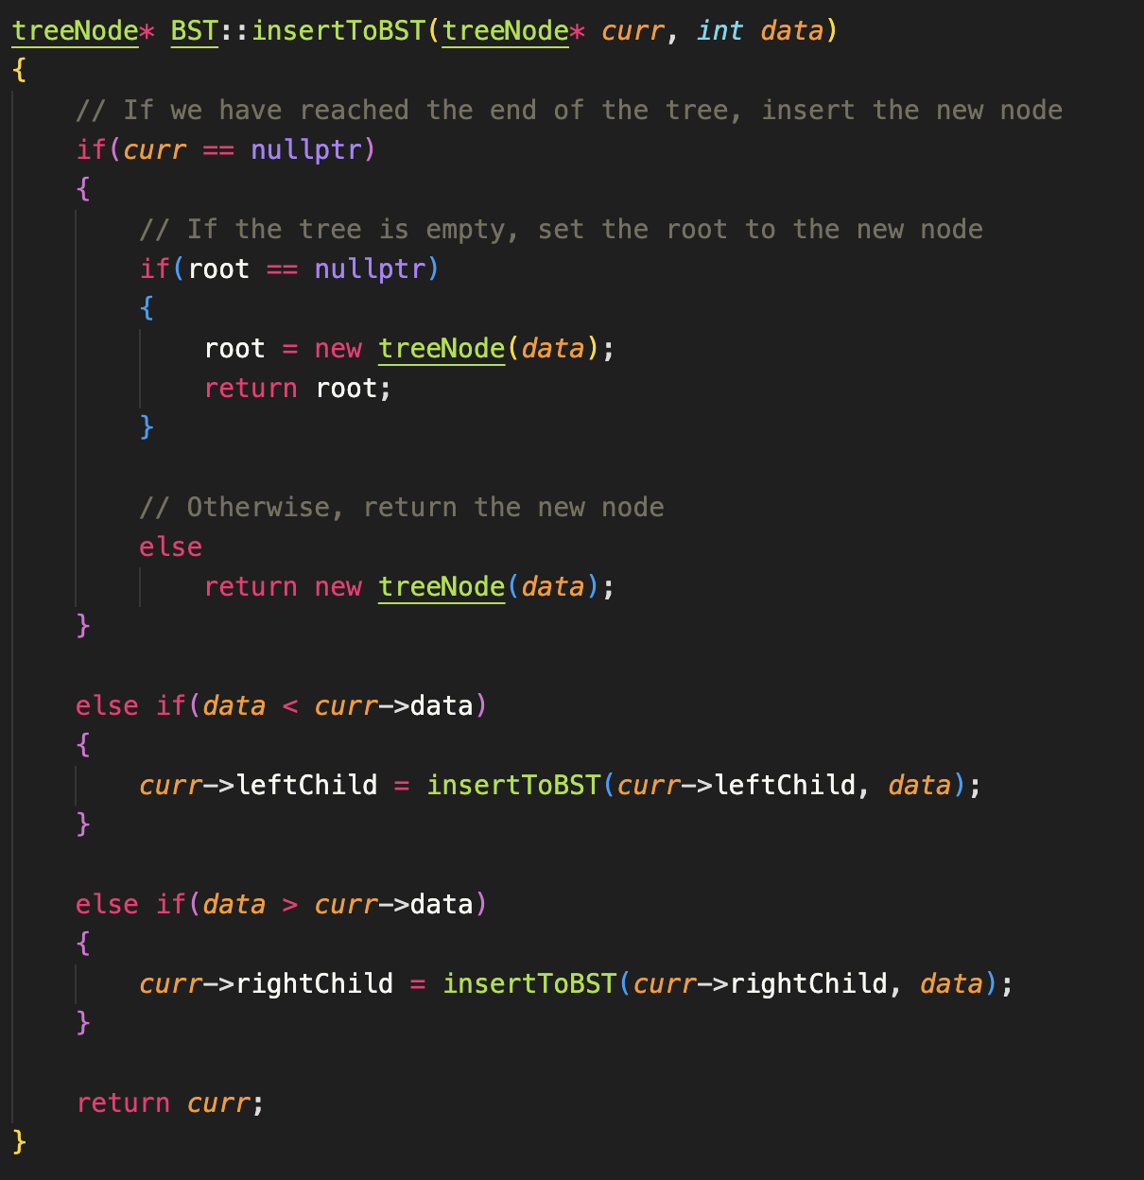
Implementation

Slide 20
BST Deletion

Slide 21
BST Deletion
We have to deal with 3 cases when doing BST deletion
Node that we’re deleting has no children
Delete the node
Node that we’re deleting has 1 child
Replace said node with its child node’s value, then delete the child
Node that we’re deleting has 2 children
Find the node’s inorder successor
Copy the value of the inorder successor/predecessor to the node then delete the inorder successor/predecessor

Slide 22
Inorder Successor/Predecessor
Successor - the inorder successor of a given node is defined as the node with the smallest value greater than the value of the given node.
Predecessor - the inorder predecessor of a given node is defined as the node with the greatest value less than the value of the given node

Slide 23
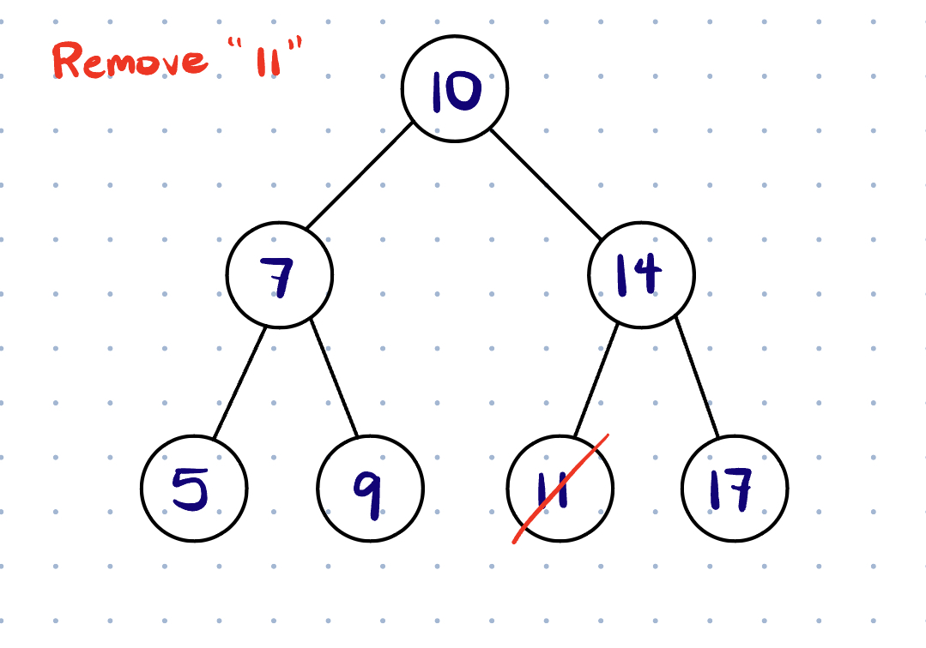
Case 1
Explanation:
11 has no children nodes, so we just delete it

Slide 24
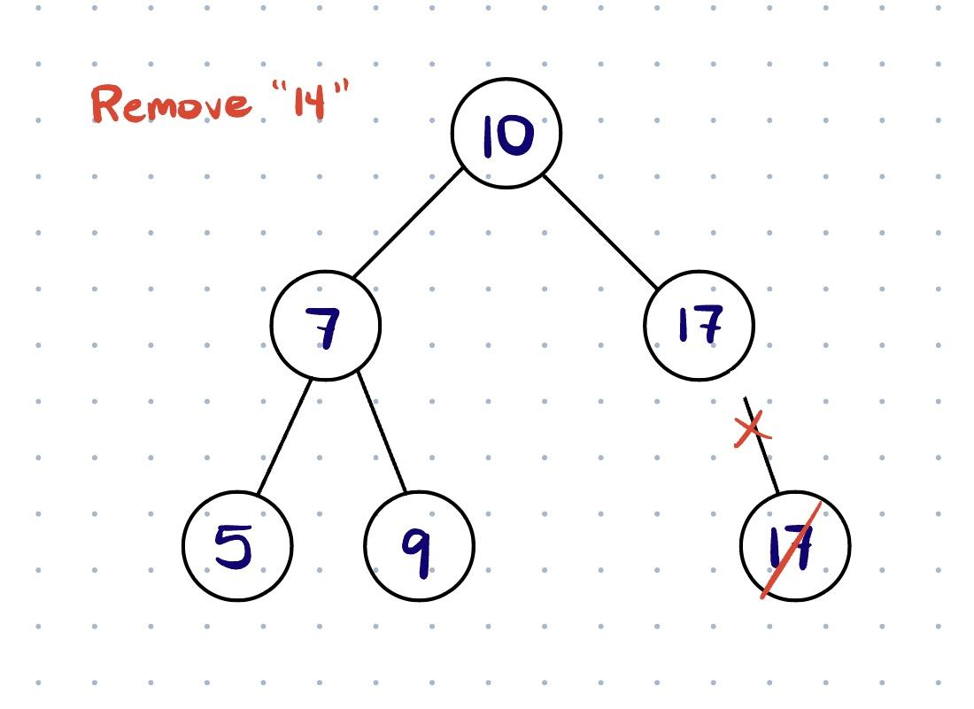
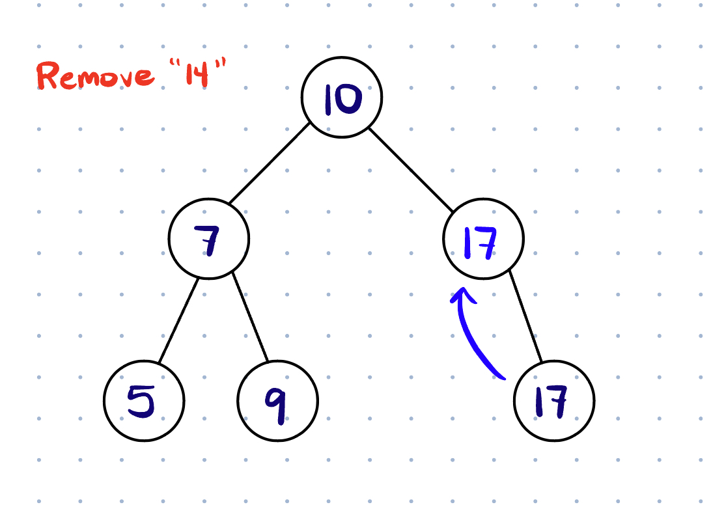
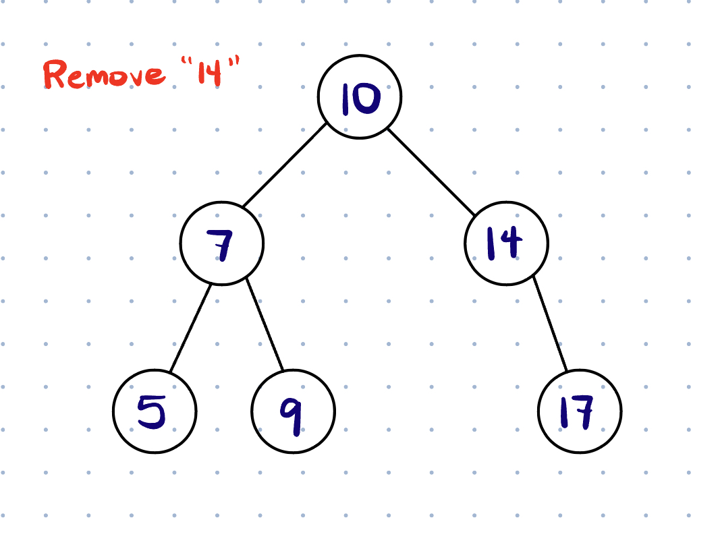
Case 2
Explanation:
14 does have 1 child node, so we need to deal with this appropriately
1.) Replace the node’s value with its child node’s value
2.) Delete the child node

Slide 25
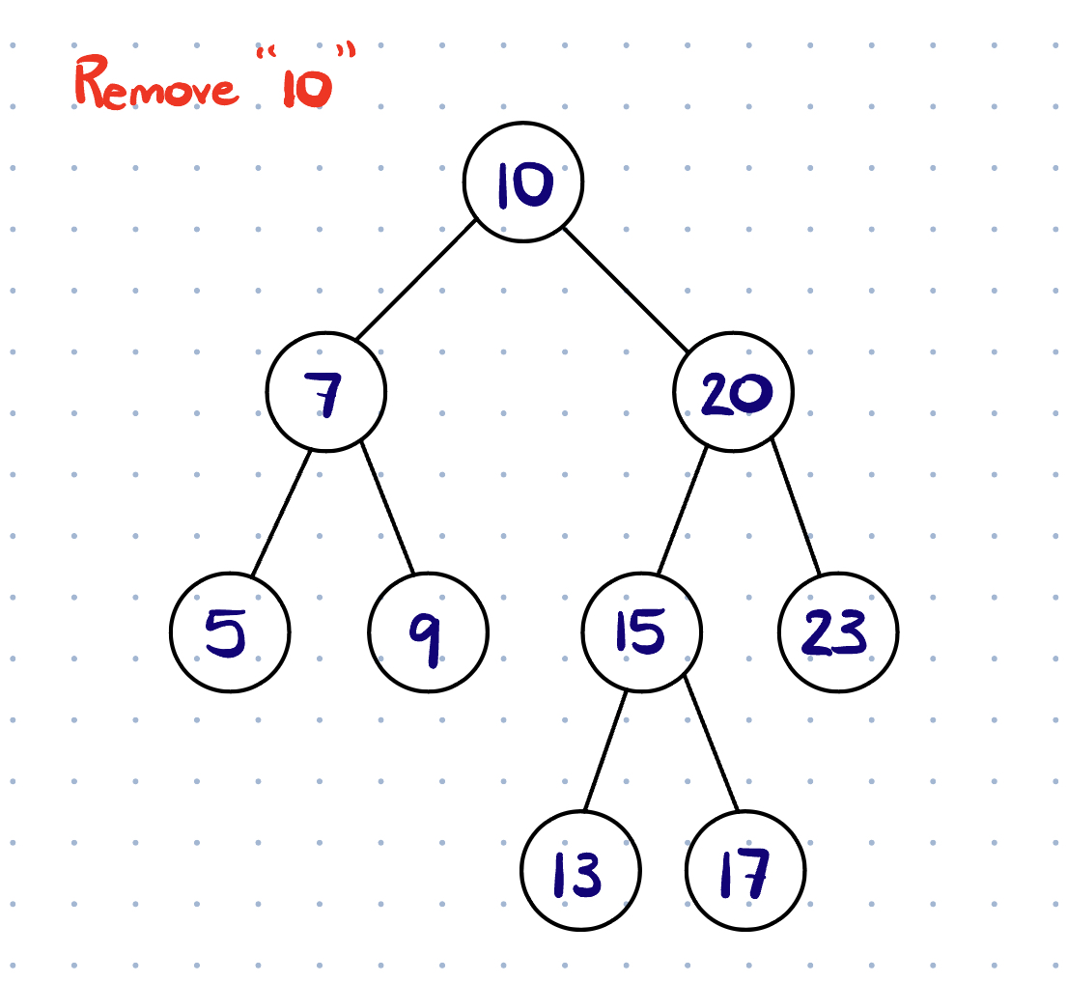
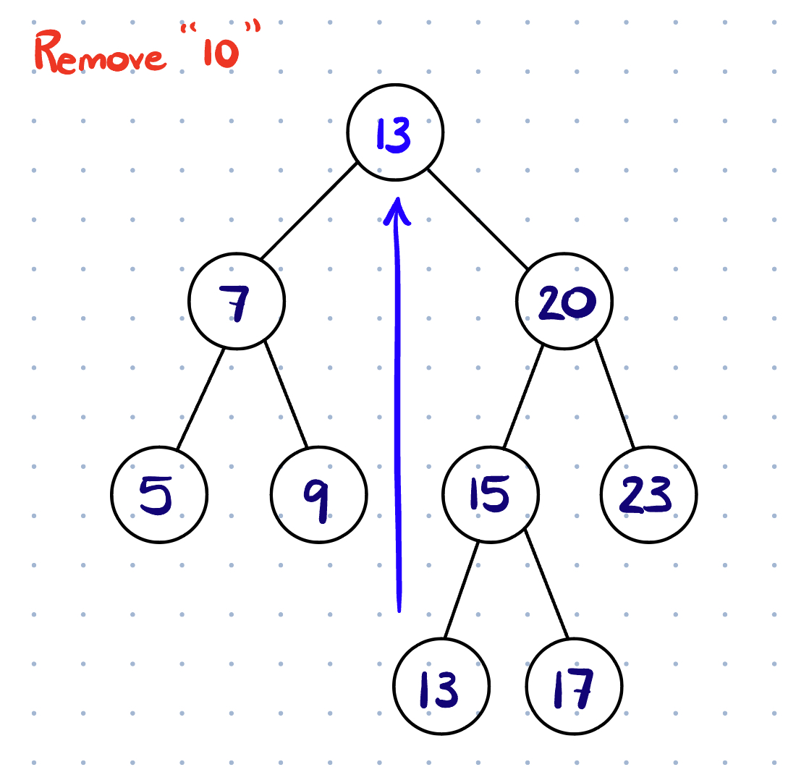
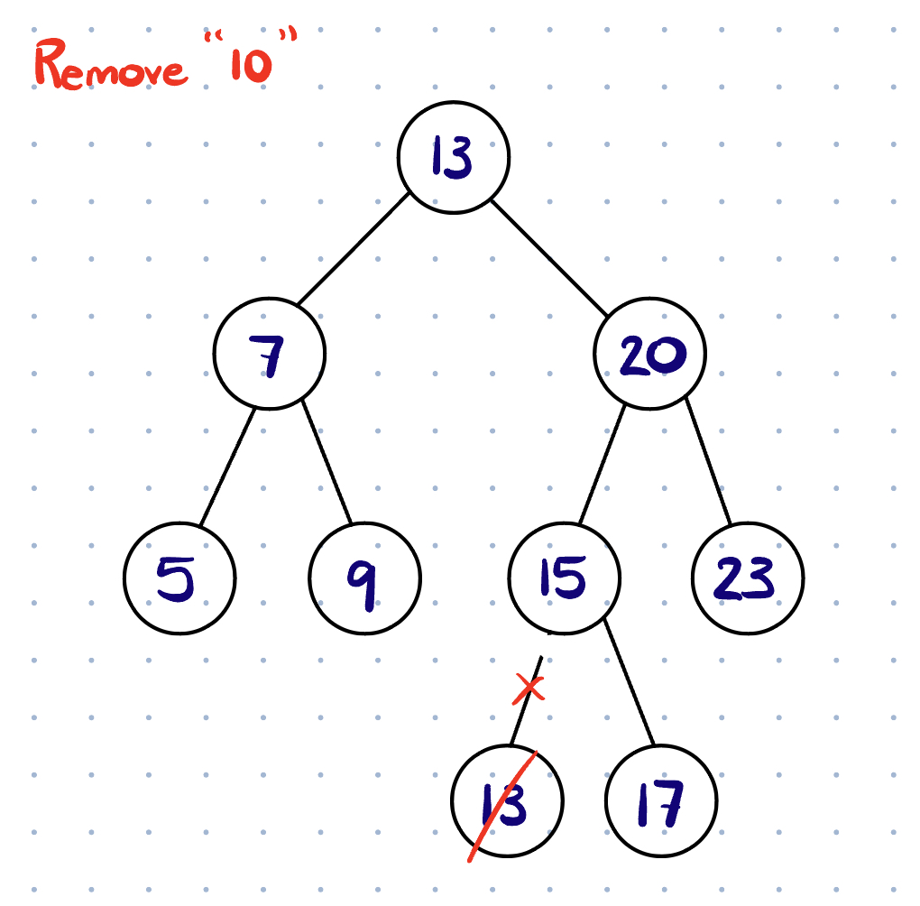
Case 3
Explanation:
10, our root node, does have 2 child nodes, so we also have to deal with this in a certain manner
1.) Find the node’s given inorder successor and copy that value to the node being removed
2.) Remove the inorder successor

Slide 26
Traversal Types

Slide 27
Inorder Traversal​
Inorder follows this outline:​
Left child, parent, right child​​
In order prints after left traversal

Slide 28
Preorder traversal
Preorder follows this outline:​
Parent, left child, right child​
Preorder prints before left traversal

Slide 29
Postorder Traversal
Postorder follows this outline:​
Left child, right child, parent
Postorder prints after right traversal

Slide 30
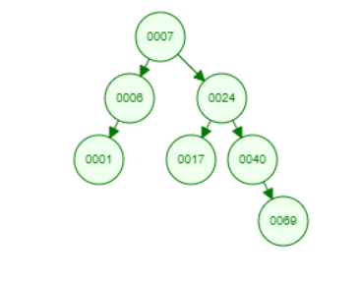
Tracing using array
Suppose we have a Tree and the root is given:
Inorder
1 | 6 | 7 | 17 | 24 | 40 | 69
Preorder
7 | 6 | 1 | 24 | 17 | 40 | 69
Postorder
1 | 6 | 17 | 69 | 40 | 24 | 7

Slide 31
isBST() Function
Implement a function that checks whether a given tree is a Binary Search Tree.
You can assume all values in the tree are unique.
bool isBST(node* curr){
}

Slide 32
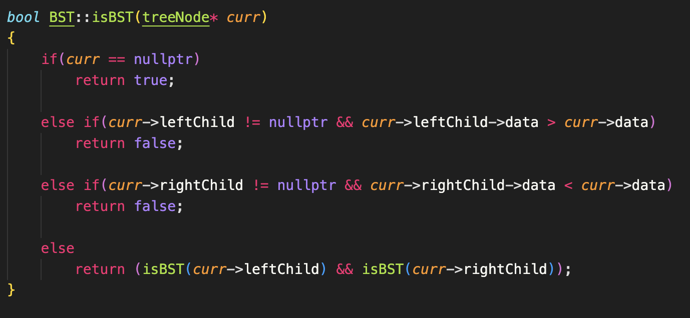
Solution

